Slide 1
K-Means Clustering
ADA AI/ML April, 2023

Slide 2
Clustering
Clustering is one of the most common exploratory data analysis technique used to get an intuition about the structure of the data.
It can be defined as the task of identifying subgroups in the data such that data points in the same subgroup (cluster) are very similar while data points in different clusters are very different.
It tries to find homogeneous subgroups within the data such that data points in each cluster are as similar as possible according to a similarity measure such as euclidean-based distance or correlation-based distance.
Clustering is considered an unsupervised learning method since we don’t have the ground truth to compare the output of the clustering algorithm to the true labels to evaluate its performance.

Slide 3
K-Means
K-means algorithm is an iterative algorithm that tries to partition the dataset into K pre-defined distinct non-overlapping subgroups (clusters) where each data point belongs to only one group.
It tries to make the intra-cluster data points as similar as possible while also keeping the clusters as different (far) as possible.
It assigns data points to a cluster such that the sum of the squared distance between the data points and the cluster’s centroid (arithmetic mean of all the data points that belong to that cluster) is at the minimum.
The less variation within clusters, the more homogeneous (similar) the data points are within the same cluster.

Slide 4
Steps in K-Means algorithm
Step 1: The initial selection of cluster centroids. Centroids are either randomly generated or selected from the data set, i.e. K random observations are declared as centroids
Repeat:
Step 2: Cluster assignment: For each observation from the data set, identify the nearest centroid (usually based on the Euclidean distance) and assign the observation to the cluster of that centroid.
Step 3: Centroid update: for each cluster, calculate a new centroid by taking the mean of all observations assigned to that cluster.
The algorithm iterates between steps 2 and 3 until one of the following conditions is met: i) no observation changes its cluster; ii) the sum of the distances is minimized (that is, falls beneath the threshold); iii) the maximum number of iterations is reached.

Slide 5
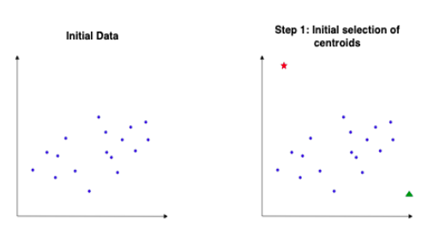
Steps in K-Means algorithm

Slide 6
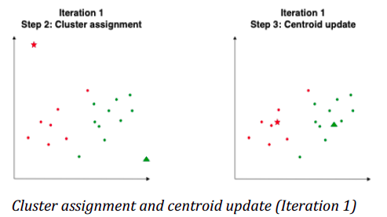
Steps in K-Means algorithm

Slide 7
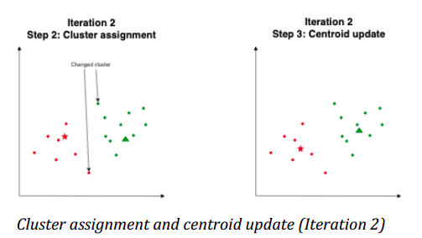
Steps in K-Means algorithm

Slide 8
Internal evaluation
When a clustering result is evaluated based on the data that was clustered itself, this is called internal evaluation. These methods usually assign the best score to the algorithm that produces clusters with high similarity within a cluster and low similarity between clusters.
One drawback of using internal criteria in cluster evaluation is that high scores on an internal measure do not necessarily result in effective information retrieval applications.
Internal validation measures reflect often the compactness, the connectedness and the separation of the cluster partitions.
Compactness or cluster cohesion: Measures how close are the objects within the same cluster.
Separation: Measures how well-separated a cluster is from other clusters.
Connectivity: corresponds to what extent items are placed in the same cluster as their nearest neighbors in the data space.

Slide 9
Internal evaluation
There are more than a dozen of internal evaluation measures.
The Silhouette coefficient contrasts the average distance to elements in the same cluster with the average distance to elements in other clusters. Objects with a high silhouette value are considered well clustered, objects with a low value may be outliers.
The Davies–Bouldin index (DBI), uses quantities and features inherent to the dataset to evaluate how well the clustering has been done.
Calinski-Harabasz (CH) Index is a measure of how similar an object is to its own cluster (cohesion) compared to other clusters (separation).

Slide 10
External evaluation
In external evaluation, clustering results are evaluated based on data that was not used for clustering, such as known class labels (if available) and external benchmarks. Such benchmarks consist of a set of pre-classified items, and these sets are often created by (expert) humans. Thus, the benchmark sets can be thought of as a gold standard for evaluation.
Purity: Purity is a measure of the extent to which clusters contain a single class.
The Rand index computes how similar the clusters are to the benchmark classifications.
The F-measure can be used to balance the contribution of false negatives.

Slide 11
Pros & Cons
Cons:
Choosing K (Elbow method in selecting number of clusters doesn’t always work).
Being dependent on initial values.
Clustering data of varying sizes and density (k-means clustering can only find convex clusters).
Clustering outliers.
Scaling with number of dimensions.
Gives more weight to the bigger clusters.
Pros:
Relatively simple to implement.
Scales to large data sets.
Guarantees convergence.
Easily adapts to new examples.
Good in capturing structure of the data if clusters have a spherical-like shape.

